Slide 1
New Digital Technology Hub for MIT
BY: Brodie Allen & Nikhil ladhani

Slide 2
Digital technology Hub
Simple accessible website for:
Events – Get events info held within MIT or Auckland (Technology)
News – Get to know new Technology interventions being discovered (Tesla)
Timetable – Don’t know where your class is or what it is about? Get on the New MIT hub for more info
Lecturer Profiles – Don’t know who your lecturer is or what he/she teaches? Get on the New Hub

Slide 3
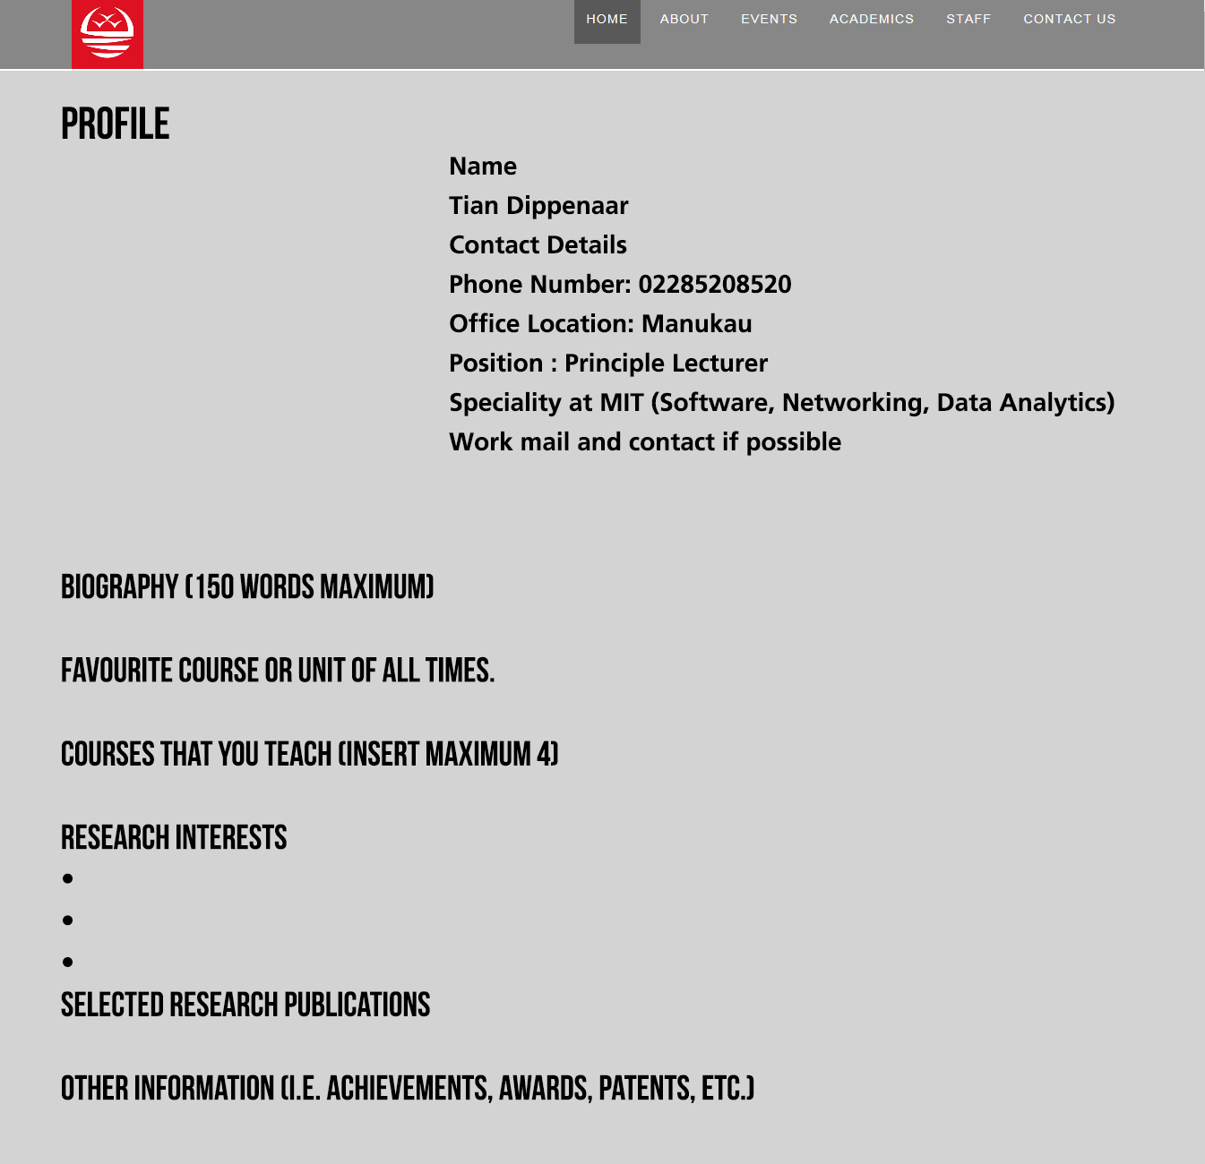
Lecturer profile WireFrame

Slide 4
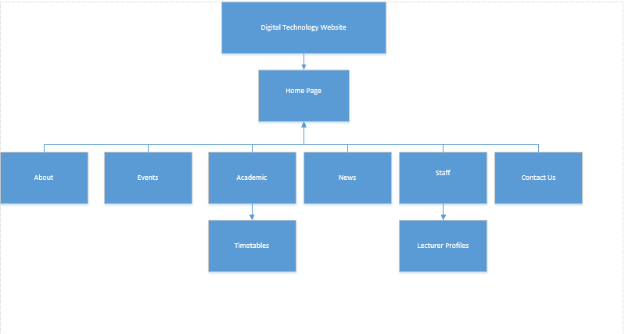
Navigation diagram

Slide 5
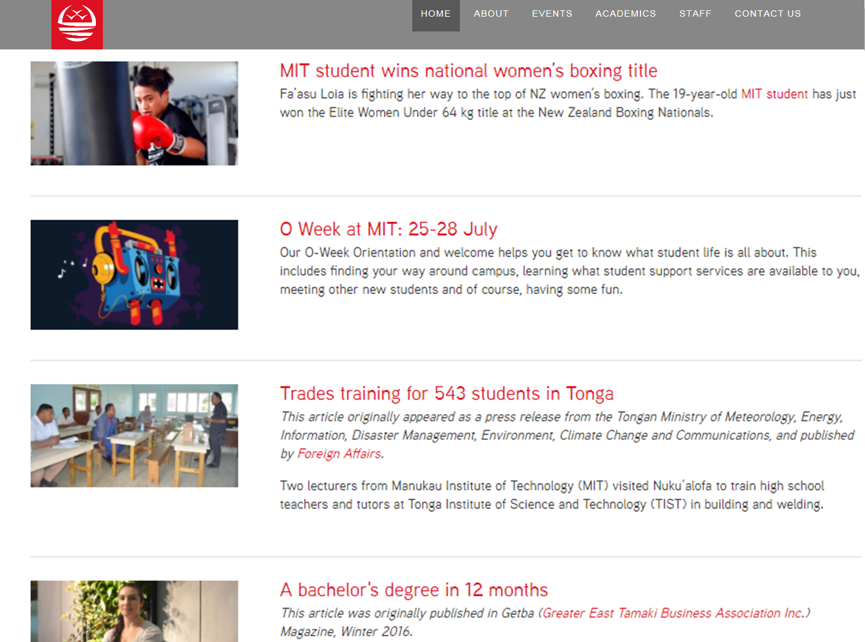
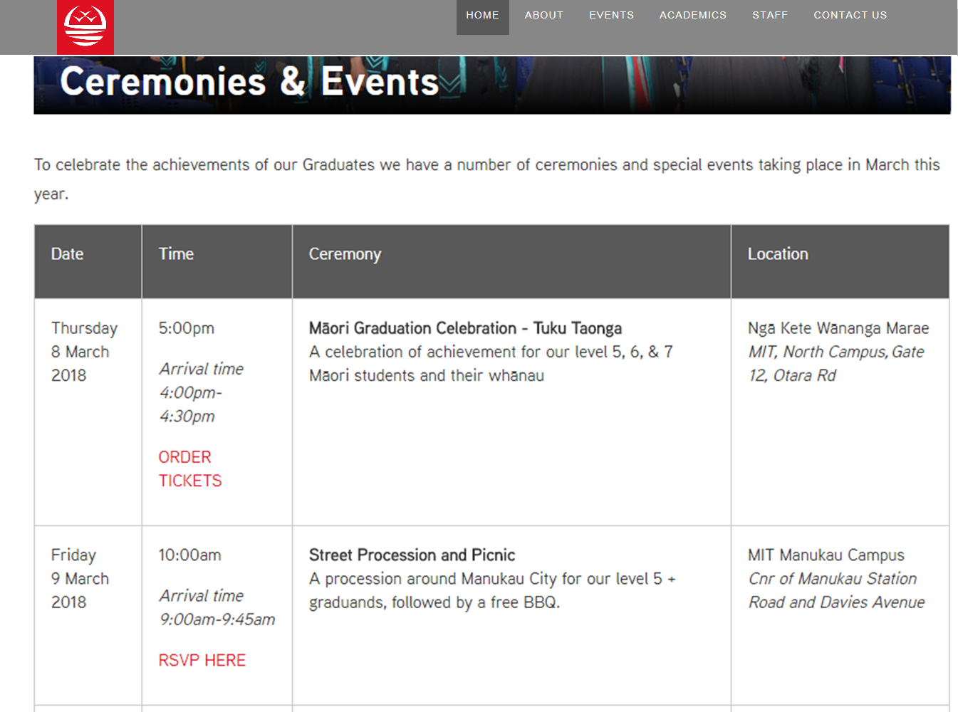
NEws

Slide 6
EVeNTS

Slide 7
Errors and restrictions
Work load – out of uni
Wordpress PHP code Management
New Language to be learned form scratch
Not fully functional – 60% working 40% not working
Shifting from HTML to PHP/HTML
No reply from lecturers yet for lecturer profile (2/15)
Internet connection problems

